Slide 1
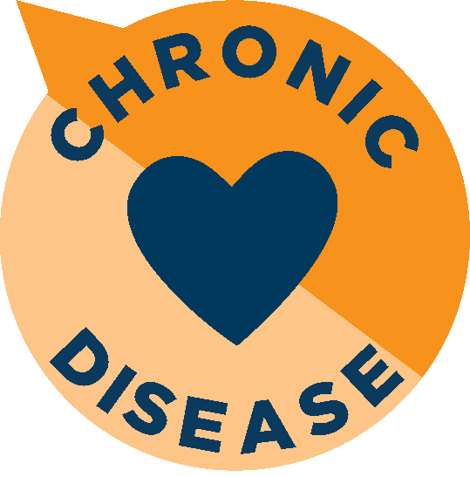
Chronic diseases account for seven out of ten deaths in the United States. That is the bad news. The good news is that chronic disease is largely preventable. The following pages contain verbiage, tips, a printable poster and other articles and resources that you can reference and share with your co-workers and employees.

Slide 2
What and Why
All of us are impacted by chronic disease. If not us as individuals, we likely have friends or loved ones that are suffering from long-term, persistent health issues such as heart disease, stroke, cancer, type 2 diabetes, obesity and arthritis. Knowledge is power. This month, we will learn more about chronic diseases and steps we can take to prevent them.

Slide 3
Ideas for activities
Organize a CPR training opportunity for your team. The Red Cross offers trainings regularly. Heart.org or RedCross.org
Take a moment to learn your family health history. Too often, we don’t know certain issues or diseases are common in your family until it is too late. Knowing in advance can help you catch the warning signs earlier.
Take the survey. Are you pre-diabetic?

Slide 4
resources
Articles
Treating Chronic Disease With Exercise
Turn the Page on Chronic Disease
How Apps Can Help Manage Chronic Diseases
Videos
The Epidemic of Chronic Disease and Understanding Epigenetics – Kent Thornburg
Learn More About Chronic Diseases
Illness Intelligence: Don’t Say This to Someone Who Is Sick | Kelly Medwick
Chronic Diseases: Everyone’s Business

Slide 5
25 tips
Chronic diseases and conditions—such as heart disease, stroke, cancer, type 2 diabetes, obesity, and arthritis—are among the most common, costly, and preventable of all health problems.
About 86 million US adults—more than a third—have prediabetes, and 90 percent of them don’t know it.
People with prediabetes who take part in a structured lifestyle change program can cut their risk of developing type 2 diabetes by as much as 58 percent.
Cardiovascular disease is the leading cause of death for people of most racial and ethnic groups in the United States, but risk is highest for certain racial minority groups.
Cancer screenings can help prevent as well as find colon, cervical, and breast cancers early, when treatment works best.
Smoking causes about 90 percent of lung cancer deaths in men and nearly 80 percent in women.

Slide 6
More tips
Chronic diseases are responsible for 7 of 10 deaths each year.
Treating people with chronic diseases accounts for most of our nation’s health care costs..
Type 1 diabetes is characterized by a lack of insulin production and type 2 diabetes results from the body's ineffective use of insulin.
Type 2 diabetes is much more common than type 1 diabetes, and accounts for around 90 percent of all diabetes worldwide.
A stroke occurs when blood flow to an area of brain is cut off. When this happens, brain cells are deprived of oxygen and begin to die.
Diabetes causes 6 deaths every minute and one in 20 deaths in the world is due to the condition.
Because high blood pressure and prehypertension often have no symptoms, checking your blood pressure is the only way to know for sure whether it is too high.

Slide 7
More tips
Every two hours you spend watching TV instead of pursuing something more active increases the chances of developing diabetes by 20 percent; it also increases the risk of heart disease Being obese makes you 20 to 40 times more likely to develop diabetes than someone with a healthy weight.
Cardiovascular diseases are diseases of the heart and blood vessel system that include damage to blood vessel and the inability for your heart and vessels to have blood flow properly
When the body doesn’t have enough insulin, or can’t use it effectively, blood sugar builds up in the blood. High blood sugar levels can lead to heart disease, stroke, blindness, kidney failure, and amputation of toes, feet, or legs.
More than 20 percent of health care spending is for people with diagnosed diabetes.
African Americans have the highest prevalence of high blood pressure of all US population groups, and are twice as likely as whites to die of preventable heart disease and stroke.

Slide 8
More tips
Heart disease is a lifelong condition—once you get it, you'll always have it.
Arthritis is the inflammation of one or more joints. Symptoms include pain, swelling, reduced range of motion, and stiffness.
Every 42 seconds, someone in the United States has a heart attack, and every 4 minutes, someone dies of stroke.
Maintain a healthy weight and protect their joints. People can reduce their risk of knee osteoarthritis by controlling their weight and avoiding types of activities that are more likely to cause joint injuries.
The term arthritis refers to more than 100 diseases and conditions, including gout, lupus and rheumatoid arthritis, affecting the joints.
In the United States, 23 percent of all adults, or over 54 million people, have arthritis. It is a leading cause of disability. The annual direct medical costs are at least $81 billion.
More than 29 million US adults have diabetes, and 25% of them don’t know it.

Slide 9
Appendix
CDC.gov
Heart.org
NIH.gov
Stroke.org
Diabetes.org
Who.int
Medindia.net
Hsph.Harvard.edu

